Slide 1

Collaboration Architecture
February 4, 2009
Service Based Platform for enabling & driving growth

Slide 2

Collaboration Services Platform
Unified Communication services
Scheduling services
Metadata management services
Provisioning services
Presentation layer services
Workflow / Event-Driven services
SLM services (monitoring, governance, load balancing)
Analysis services (data mining, analytics, and insights)
Integration services
Aggregation services

Slide 3
Collaboration Services Platform
Social Networking services
Knowledge Consumption services (spans aggregation, includes assimilation and search)
Knowledge management services (business rules)
Synchronous collaboration services (IM, video conferencing, audio conferencing, telephony)
Asynchronous collaboration services (wiki’s, blogs, discussions, forums, document mgmt, email)
Note: As collaboration services grow in importance, the platform will migrate to an on demand model.

Slide 4
Enabling Hospira
Best Practices
Documentation, Education, Communication
Guiding Principles & Frameworks
Share Results
Focus on Customer
Aligning desired outcomes
Aligning priorities
Cooperative innovation
Shared goals for customer satisfaction
Knowledge Sharing
Common goals & metrics
Sharing information
Common product codes
Shared semantics
Collaborative Workforce
Teamwork orientation
Customer focused
Open & shared communications
Service oriented goals & incentives
Shared Supply Chain
Sustained value
Agile and Integrated
Customer Focused
Collaborative
Strategic Issues btwn Trading Partners
Common Goals Common Measures
Specific Measures & Priorities
Add’l Knowledge Sharing Opportunities

Slide 5
Eliminating the bottlenecks
IT
Operations
Sales
Marketing
Contract Mgmt
R&D
Quality
IT
Operations
Sales
Marketing
Contract Mgmt
R&D
Quality
IT
Operations
Sales
Marketing
Contract Mgmt
R&D
Quality
From: Single Point of Contact
All interaction funneled through one point of contact
Limited information sharing
Limited productivity
To: Peer-to-Peer Contact
Better internal alignment
Subject matter experts work together toward a common goal
Trust built inside and between organizations
Information is shared
People are empowered to do the right thing

Slide 6
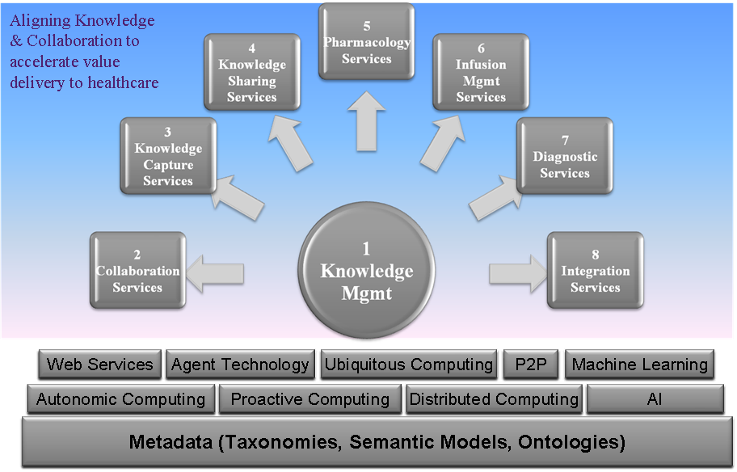
Enabling Healthcare

